Slide 1
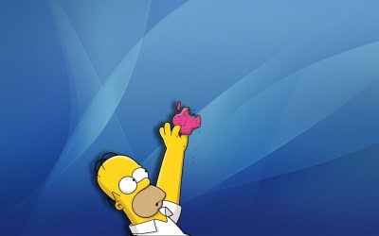
Passive voice (trpnik)

Slide 2
Active voice (tvornik)
Ko osebek nekaj dela, uporabimo tvornik (ACTIVE)
E.g.: People sell good luck flowers.
Glagol v tvorniku (lahko v različnih časih)
osebek (vršilec -doer)
Predmet (ˮprejemnik“ - receiver)

Slide 3
Passive voice (trpnik)
Uporablja se, ko je dejanje pomembnejše od vršilca (kdo/kaj je to naredil).
Vršilec dejanja je na mestu predmeta, pred njim stoji by. Lahko ga tudi izpustimo.
E.g.: Good luck flowers are sold by people.
Glagol v trpniku
(lahko je v razl.časih)
osebek ( receiver)
Predmet (Doer)

Slide 4
Oblika:
Osebek + glagol biti v ustreznem času + Past Participle/-ed
(3. oblika)

Slide 5
Tvornik (Active) in trpnik (Passive)
čas |  | osebek | glagol | predmet
Present Simple | Active: | Rita | writes | a letter.
 | Passive: | A letter | is written | by Rita.
Past Simple | Active: | Rita | wrote | a letter.
 | Passive: | A letter | was written | by Rita.
Present Perfect | Active: | Rita | has written | a letter.
 | Passive: | A letter | has been written | by Rita.
Future Simple | Active: | Rita | will write | a letter.
 | Passive: | A letter | will be written | by Rita.
Modalni glagoli | Active: | Rita | can write | a letter.
 | Passive: | A letter | can be written | by Rita.

Slide 6
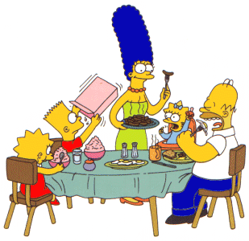
Practice
People eat moon cakes at Mid-Autumn Festival.
Moon cakes are eaten (by people) at Mid-Autumn festival.

Slide 7
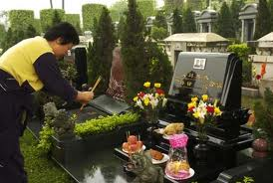
People swept graves with brooms at Ching Ming Festival.
Graves were swept with brooms (by people) at Ching Ming Festival.

Slide 8
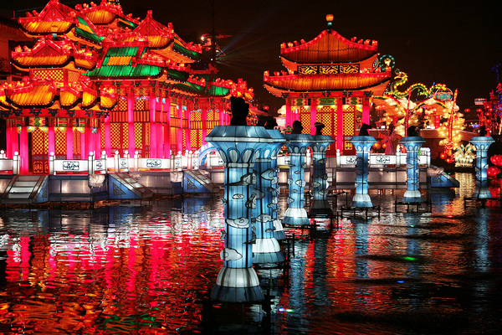
People will light lanterns at Mid-Autumn Festivals.
Lanterns will be lit (by people) at Mid-Autumn Festivals.

Slide 9
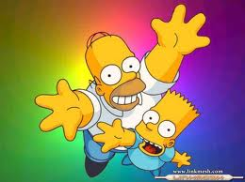
GAME TIME!

Slide 10
People swept graves. Graves __________________.
were swept
Is swept
Are swept
Sweep
Were swept

Slide 11
People will buy some flowers. Some flowers ______________.
will be bought
Is bought
Will be bought
Are bought
Buyed

Slide 12
Miss Lee paints a picture. A picture ___________ by Miss Lee.
is painted
Painted
Are painted
Paint
Is painted

Slide 13
The brother made a cake. A cake ___________ by the brother.
was made
maked
Is made
was made
Is make

Slide 14
John buys some new clothes. Some new clothes _________ by John
are bought
bought
Is bought
Are bought
Be bought

Slide 15
The family clean the house. The house __________________.
Is cleaned by the family
Is cleaned by the family
Are cleaned by the family
Cleaned by the family
Clean by the family

Slide 16
Mr. Chan places some flowers Some flowers __________________.
are placed by Mr. Chan
Placed by Mr. Chan
Is Placed by Mr. Chan
Are placed by Mr. Chan
Are place by Mr. Chan

Slide 17
Sally throws the old things. The old things ___________________.
are thrown by Sally
Are threw by Sally
Is thrown by Sally
Thrown by Sally
Are Thrown by Sally

Slide 18
Peter draws a car ___________________________.
A car is drawn by Peter
A car is drew by Peter
A car is drawn by Peter
Peter is drawn by a car
Peter is drew by a car

Slide 19
Mr. and Mrs. Wu bake a cake ___________________________.
A cake is baked by Mr. and Mrs. Wu
A cake are baked by Mr. and Mrs. Wu
A cake is baked by Mr. and Mrs. Wu
A cake baked by Mr. and Mrs. Wu
A cake bake by Mr. and Mrs. Wu.

